Slide 1


Slide 2



CheXFusion+: CXR-LT classification using ensembles of multi-resolution ConvNeXt with generative long tail data
Aisha Urooj², Presenter
Team: Zuwei Guo¹, Imon Banerjee²
¹ Arizona State University ² Mayo Clinic

Slide 3
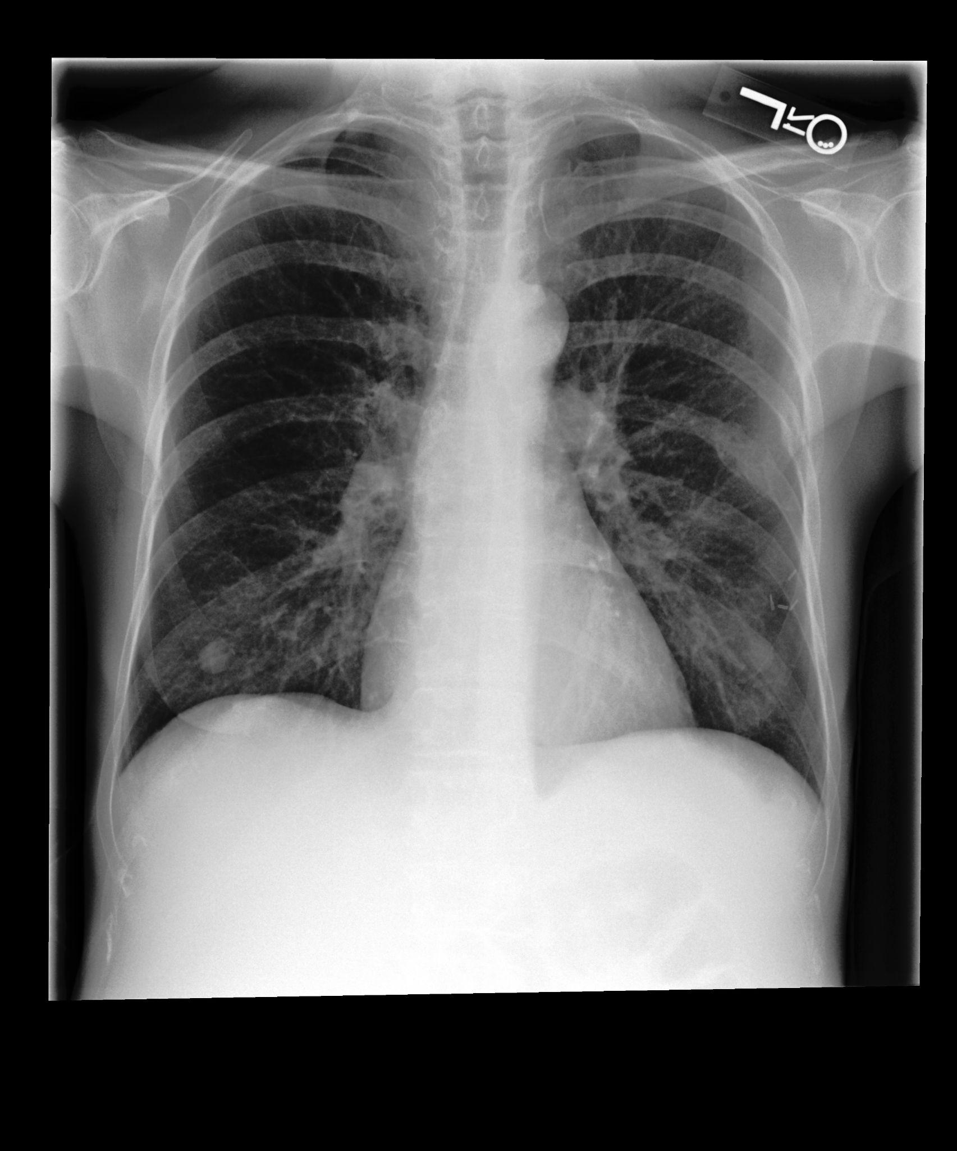
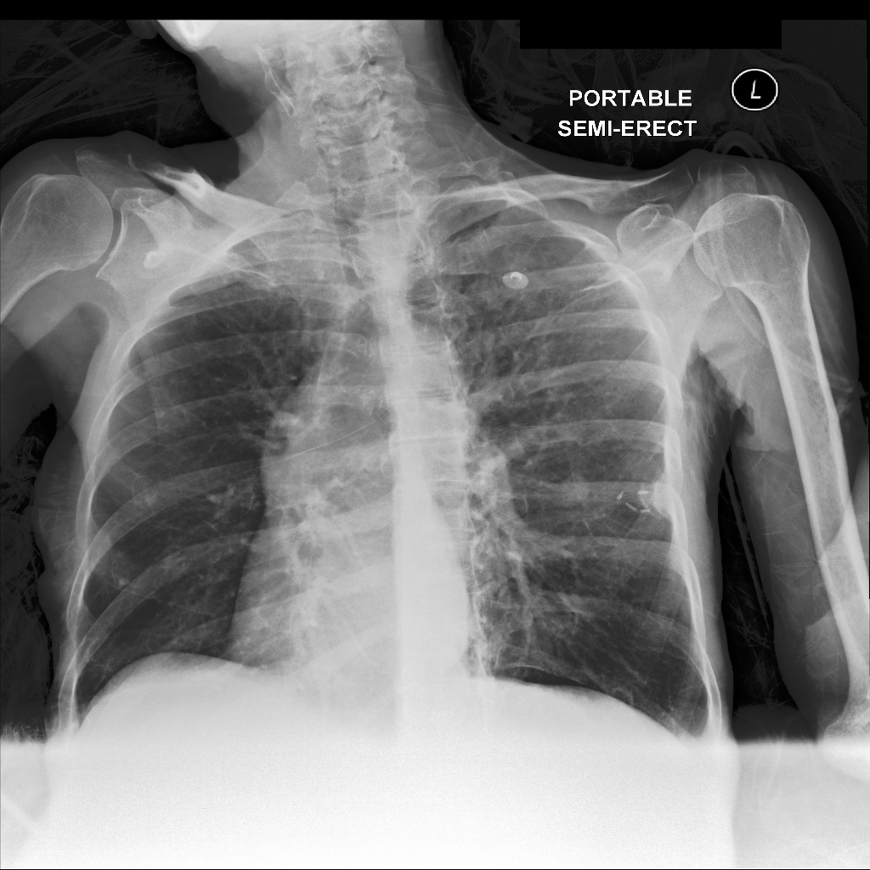
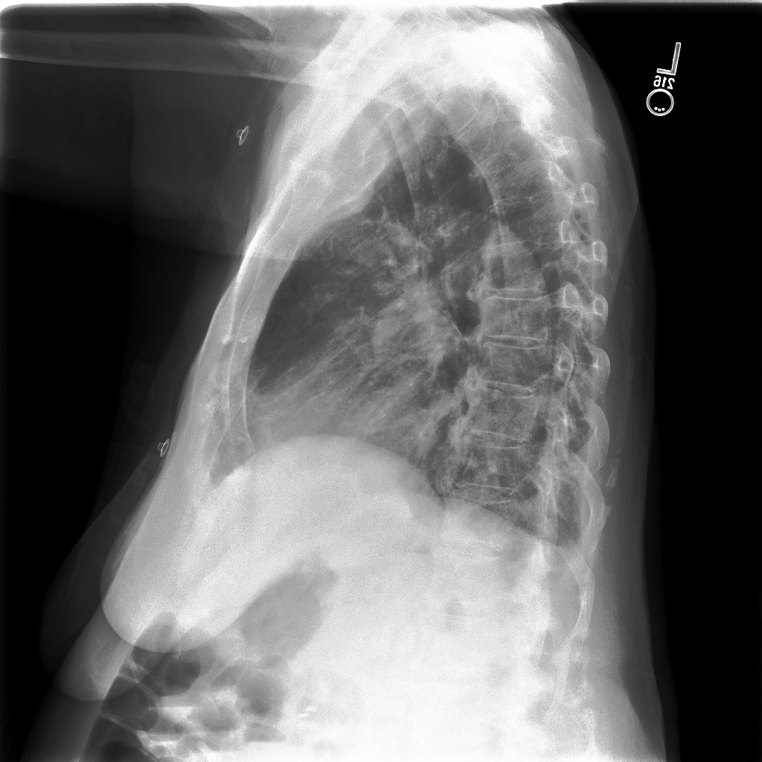
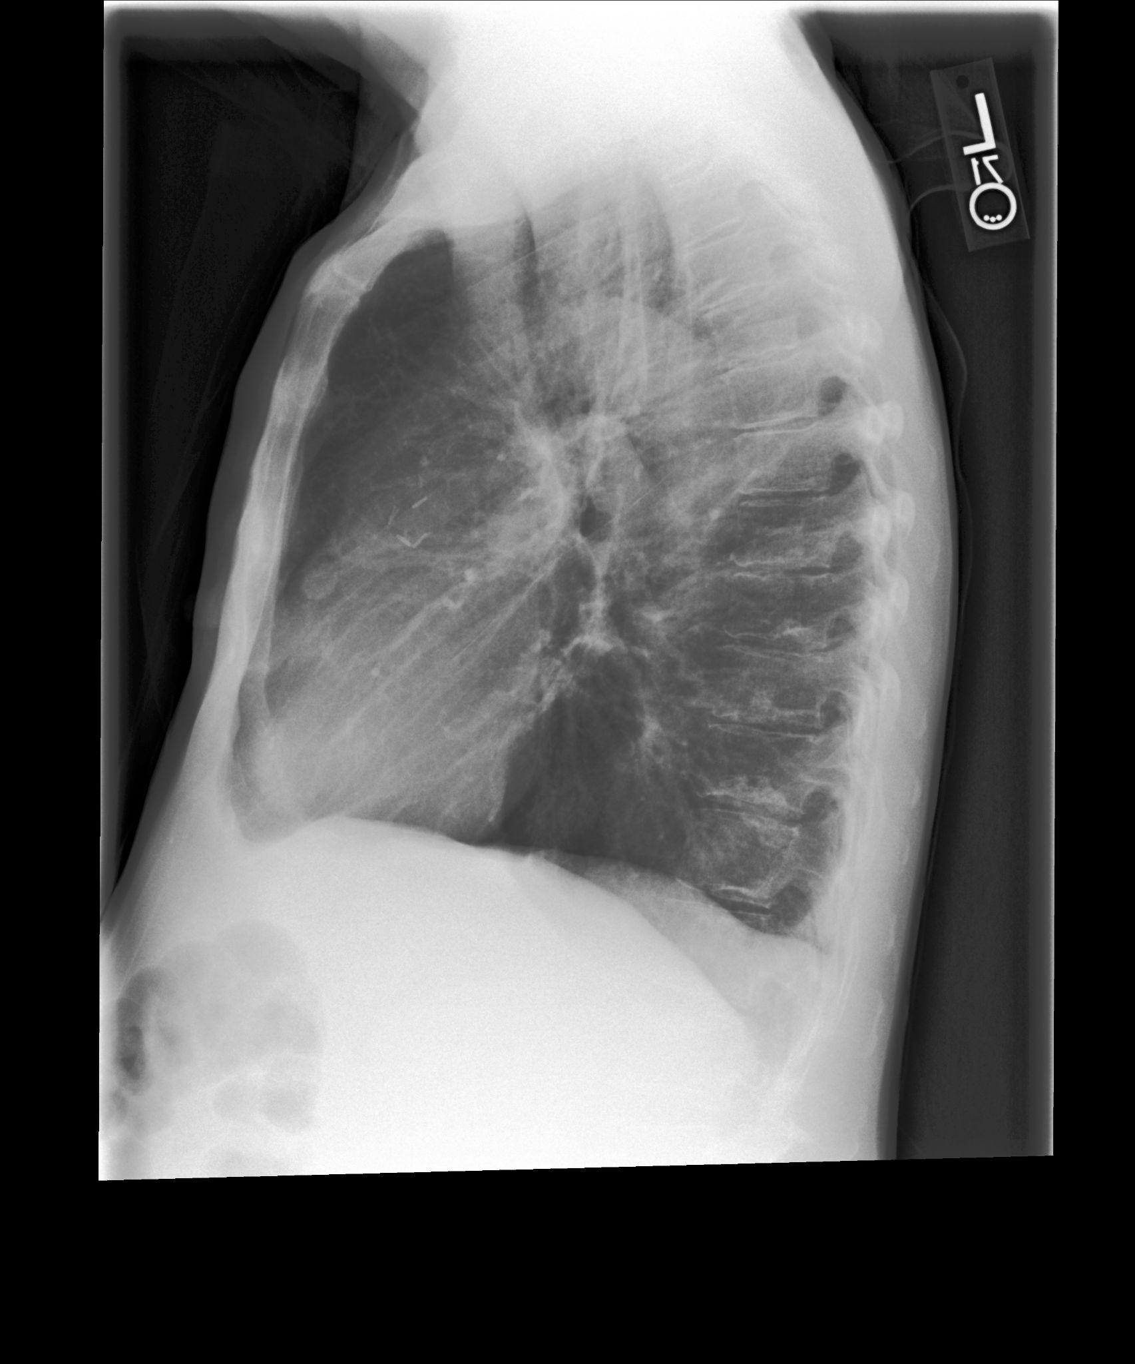
CXR-LT: Multi-Label Long-Tailed Classification on Chest X-Rays
MIMIC-CXR-JPG-2.0.0
Postero-anterior : 64470
Anterior-postero : 100024
Left-lateral : 24080
Lateral : 57546

Slide 4
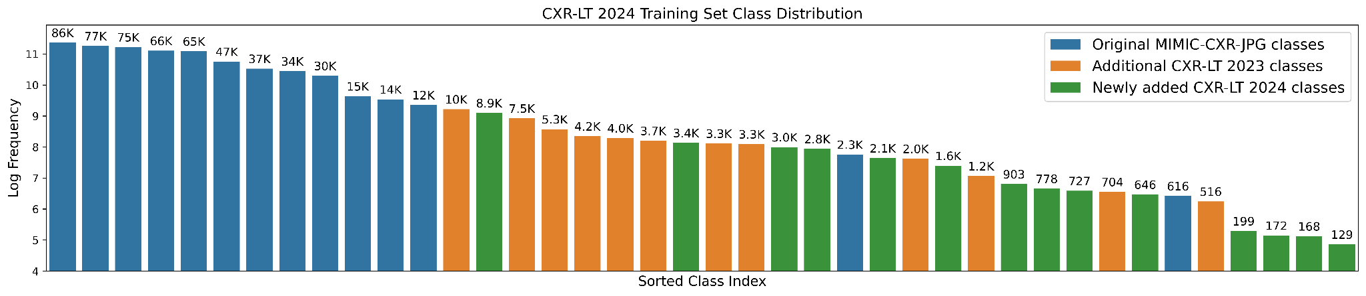
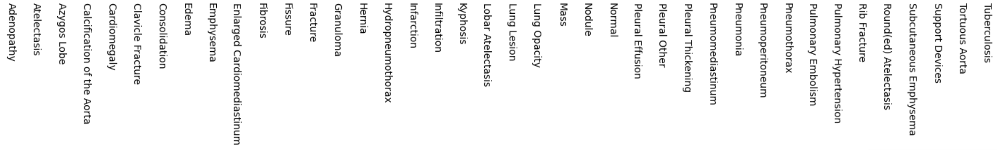
CXR-LT: Multi-Label Long-Tailed Classification on Chest X-Rays

Slide 5
Tasks
Multi-label thorax disease classification (train/test on 40 classes) (rank 1) 🥇
Multi-label thorax disease classification (train on 40 classes, test on 26 classes) (rank 2)
Multi-label, zero-shot thorax disease classification (train on 40 classes, test on 5 classes)
🥈

Slide 6
Challenges
Label co-occurrence
⇒ The tail disease often co-exist with head diseases which makes the learning the individualized signatures of the tail cases challenging
Imbalanced data distribution
⇒ Inter-class: caused by long-tail data distribution
⇒ Intra-class: negative classes dominate the multi-label classification, model is penalized heavily for false positives

Slide 7
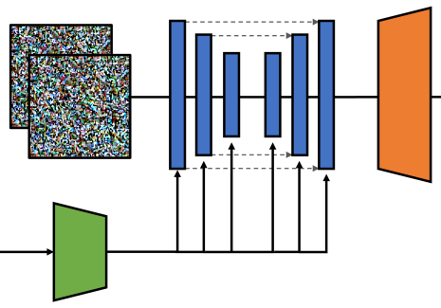
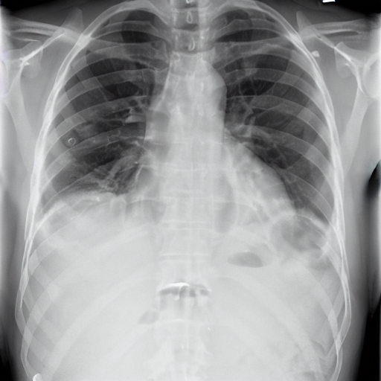
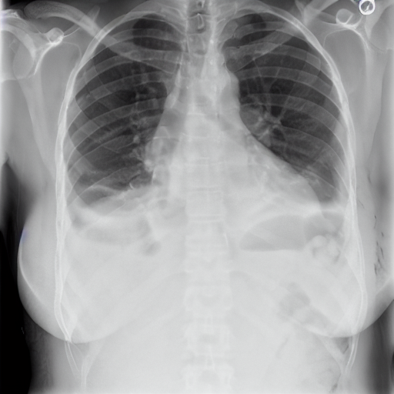


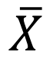
CheXFusion+
Random Gaussian Noise
Conditional Denoising U-Net
VAE Decoder
ConvNeXt-Small-224
Input: Prompts
Round(ed) Atelectasis, Pneumothorax, Pneumonia, Pleural Effusion, Lung Opacity, and Atelectasis
Text Encoder
RoentGen
ConvNeXt-Base-224
$$\overline{X}$$
ConvNeXt-Small-384
MIMIC

Slide 8
CheXFusion
1st place in 2023 challenge
CheXFusion: Effective Fusion of Multi-View Features using Transformers for Long-Tailed Chest X-Ray Classification"
Stage 1
Cross Attention
Feed Forward
+
Pooling
Noisy Student
Self-training
x 3 iterations
CNN Backbone
Positional Encoding
Cx1
Weighted ASL loss
CxD
Class queries
(CxD)

Slide 9
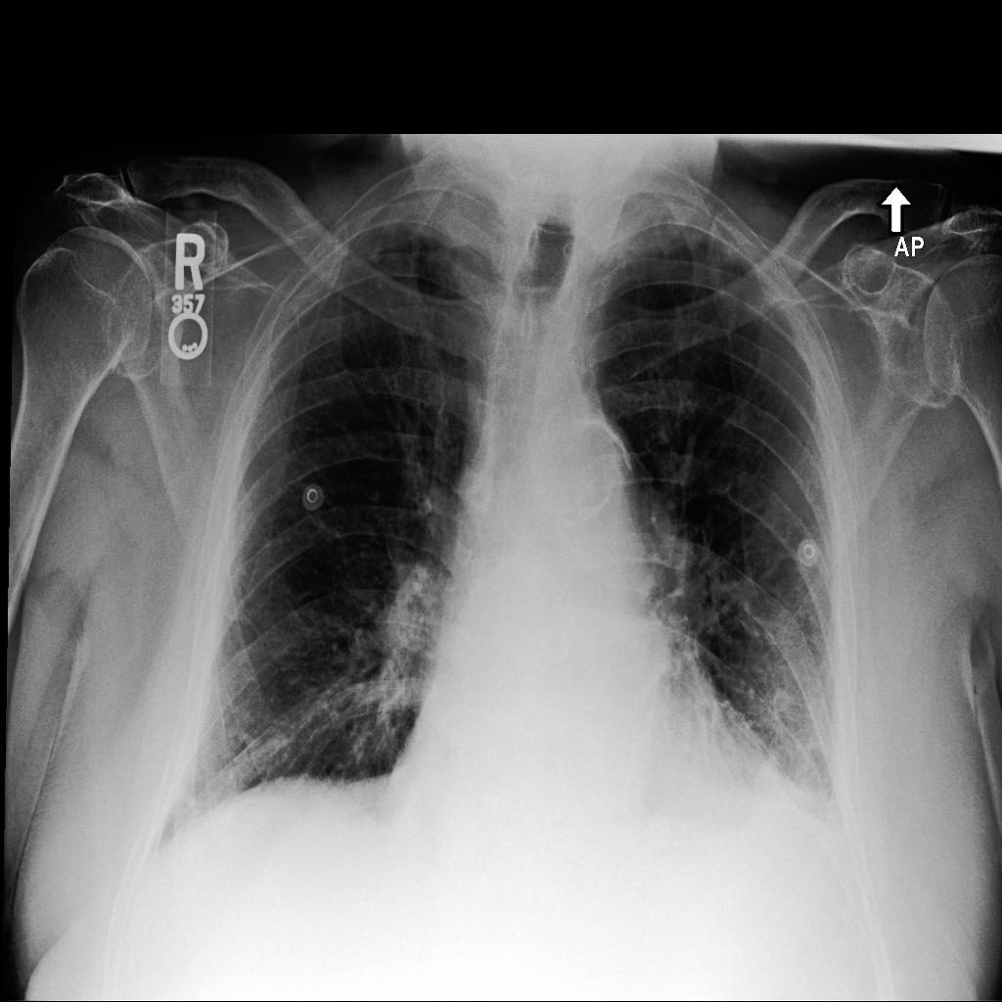
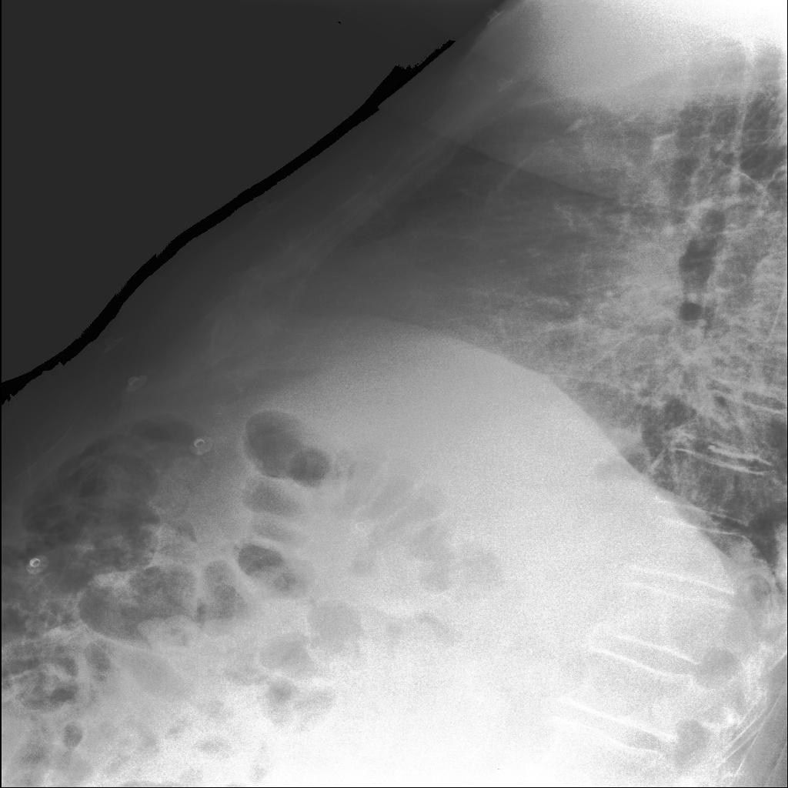
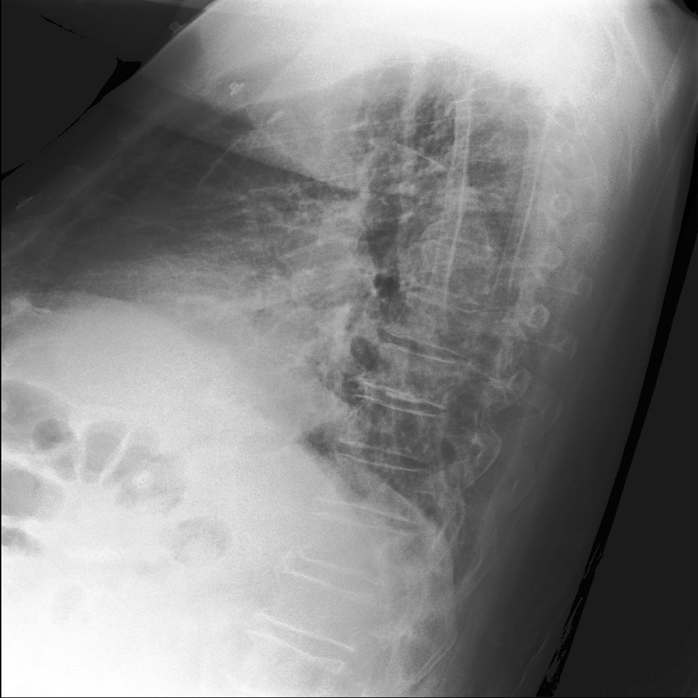
Stage 2
Positional Encoding
+
Segment Embedding
Positional Encoding
+
Segment Embedding
Transformer Encoder
Cross Attention
Feed Forward
+
Pooling
CNN Backbone (Frozen)
Conv2D
Concat
+
Padding
(NHWxD)
NHWxD
Cx1
Class queries
(CxD)
CxD
D=768, H,W=16,16
C = 40
Positional Encoding
+
Segment Embedding

Slide 10
Ensemble strategy
Tiny
2
1
224
Tiny
224
Small
3
9
ConvNeXt
4
ConvNeXt-V2
10
Base
5
11
6
384
Base
12
384
Base-Clip
7
8
Backbone
(1) ConvNeXt-T-224-wp-aug+-ga | (2) ConvNeXt-T-384-wp-aug+-ga | (3) ConvNeXt-S-224-wp-aug+-ga | (4) ConvNeXt-S-384-wp-aug+-ga
(5) ConvNeXt-B-224-wp-aug+-ga | (6) ConvNeXt-B-384-wp-aug+-ga | (7)ConvNeXt-B-Clip-224-wp-aug+-ga | (8)ConvNeXt-B-Clip-384-wp-aug+-ga
(9)ConvNeXt-V2-T-224-wp-aug+-ga | (10)ConvNeXt-V2-T-384-wp-aug+-ga | (11)ConvNeXt-V2-B-224-wp-aug+-ga | (12)ConvNeXt-V2-B-384-wp-aug+-ga
ConvNeXt-T-224-wp-aug+-ga
S/B/T: small/base/tiny, wp: with warm up, aug+: heavy augmentation, ga: gradient accumulate

Slide 11
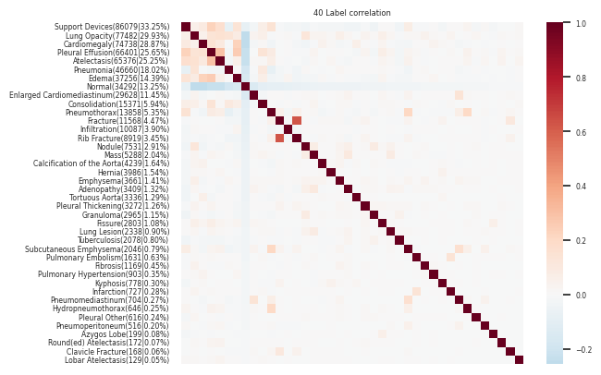
Data Augmentation -- Generate Rare Cases

Slide 12
Data Augmentation -- Generate Rare Cases
Intensive augmentation (adopt from ISIC 2019 challenge first place implementation)
To overcome the data imbalance problem on the tail cases, we use pretrained large generative models to generate new images for the tail cases
For each tail case, we random sample 100 images

Slide 13
Generate Rare Cases
Example prompt 1 “Round(ed) Atelectasis, Pneumothorax, Pneumonia, Pleural Effusion, Lung Opacity, and Atelectasis"

Slide 14
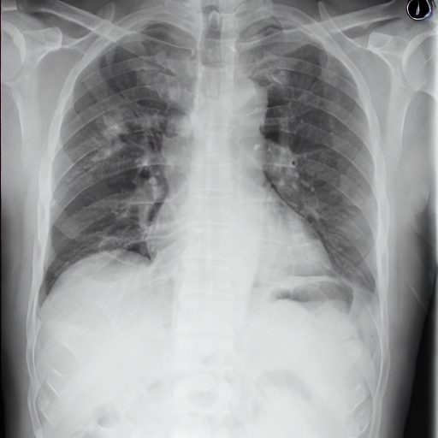
Generate Rare Cases
Example prompt 2 “Pneumoperitoneum and Lung Opacity"

Slide 15
Performance on development set
Backbone | Method | Single/ Ensemble | (development) mAP |  |  |  | AUC
 |  |  | total | head | medium | tail | total
(1) ConvNeXt-T-224-wp-aug+-ga | ChexFusion | (1) | 0.2553 | 0.4678 | 0.2081 | 0.0936 | 0.8323
(2) ConvNeXt-T-384-wp-aug+-ga |  | (2) | 0.2513 | 0.4707 | 0.2107 | 0.0756 | 0.8216
(3) ConvNeXt-S-224-wp-aug+-ga |  | (3) | 0.2581 | 0.4652 | 0.2146 | 0.0980 | 0.8284
(4) ConvNeXt-S-384-wp-aug+-ga |  | (4) | 0.2608 | 0.4708 | 0.2163 | 0.0988 | 0.8306
(5) ConvNeXt-B-224-wp-aug+-ga |  | (5) | 0.2582 | 0.4652 | 0.2145 | 0.0981 | 0.8284
(6) ConvNeXt-B-384-wp-aug+-ga |  | (6) | 0.2594 | 0.4729 | 0.2141 | 0.0947 | 0.8274
(7) ConvNeXt-BC-224-wp-aug+-ga |  | (7) | 0.2665 | 0.4728 | 0.2212 | 0.1089 | 0.8324
(8) ConvNeXt-BC-384-wp-aug+-ga |  | (8) | 0.2682 | 0.4726 | 0.2232 | 0.1122 | 0.8394
(9) ConvNeXt-V2-B-224-wp-aug+-ga |  | (3)(4)(6)(10) | 0.2813 | 0.4855 | 0.2382 | 0.1236 | 0.8469
(10) ConvNeXt-V2-B-384-wp-aug+-ga |  | (3)(4)(6)(8)(10) | 0.2816 | 0.4867 | 0.2391 | 0.1223 | 0.8472
 |  | (1)(2)(3)(4)(6)(7)(8)(10) | 0.2824 | 0.4872 | 0.2384 | 0.1249 | 0.8478
 |  | (1)(2)(3)(4)(6)(7)(8)(9)(10) | 0.2824 | 0.4881 | 0.2376 | 0.1252 | 0.8483

Slide 16
Ablation Study with different backbones
Backbone | Method | (development) mAP
 |  | total | head | medium | tail
(1) ConvNeXt-T-224-wp-aug+-ga | ChexFusion | 0.270 | 0.468 | 0.206 | 0.140
(2) ConvNeXt-T-384-wp-aug+-ga |  | 0.271 | 0.464 | 0.201 | 0.154
(3) ConvNeXt-BC-384-wp-aug+-ga |  | 0.271 | 0.467 | 0.213 | 0.137
(4) DenseNet121-224-wp-aug+-ga |  | 0.254 | 0.456 | 0.191 | 0.121
(5) ResNeXt50-224-wp-aug+-ga |  | 0.247 | 0.452 | 0.189 | 0.106

Slide 17
Performance on development set
Backbone | Trained With Generated Image | (traning) mAP |  |  |  | AUC
 |  | total | head | medium | tail | total
ConvNeXt-BC-384-wp-aug+-ga | x | 0.2652 | 0.4731 | 0.2111 | 0.1156 | 0.8386
ConvNeXt-BC-384-wp-aug+-ga-ai | ✔ | 0.2682 | 0.4726 | 0.2232 | 0.1122 | 0.8394
Ensemble (1)(2)(3)(4)(6)(7)(8)(9)(10) | x | 0.2824 | 0.4881 | 0.2376 | 0.1252 | 0.8483
Ensemble (1)(2)(3)(4)(6)(7)(8*)(9)(10) | ✔ | 0.2827 | 0.4892 | 0.2344 | 0.1282 | 0.8532

Slide 18
Wrap Up
Ensemble greatly improves the performance
Utilizing generated tail case images improves score
State-of-the-art results for Chest X-ray long-tail classification

Slide 19

CXR-LT classification using ensembles of multi-resolution ConvNeXt with generative long tail data
Try it for yourself
zguo32@asu.edu
https://github.com/
AbhorsenKnight/CXR_LT_24_Challenge

Slide 20
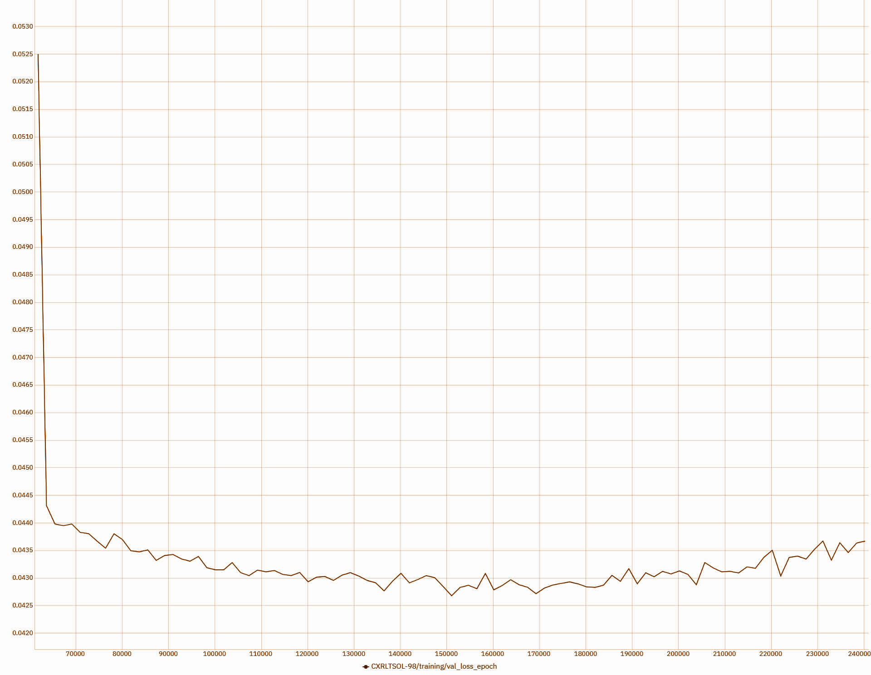
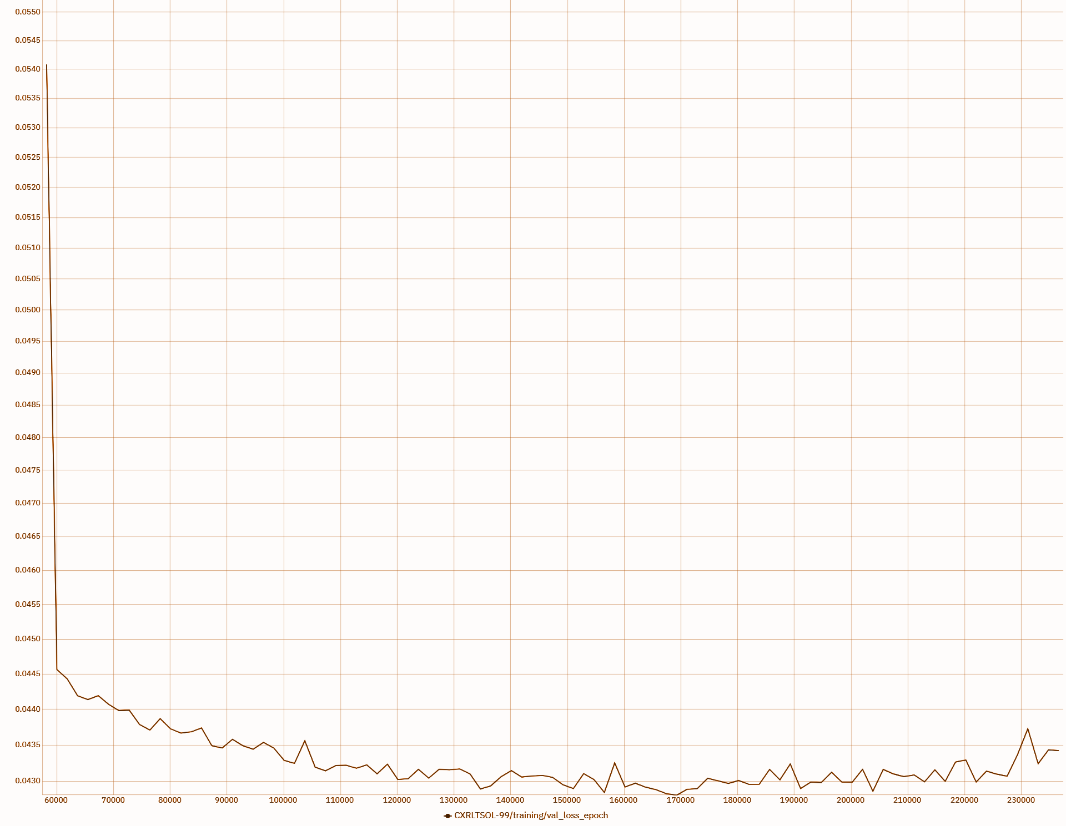
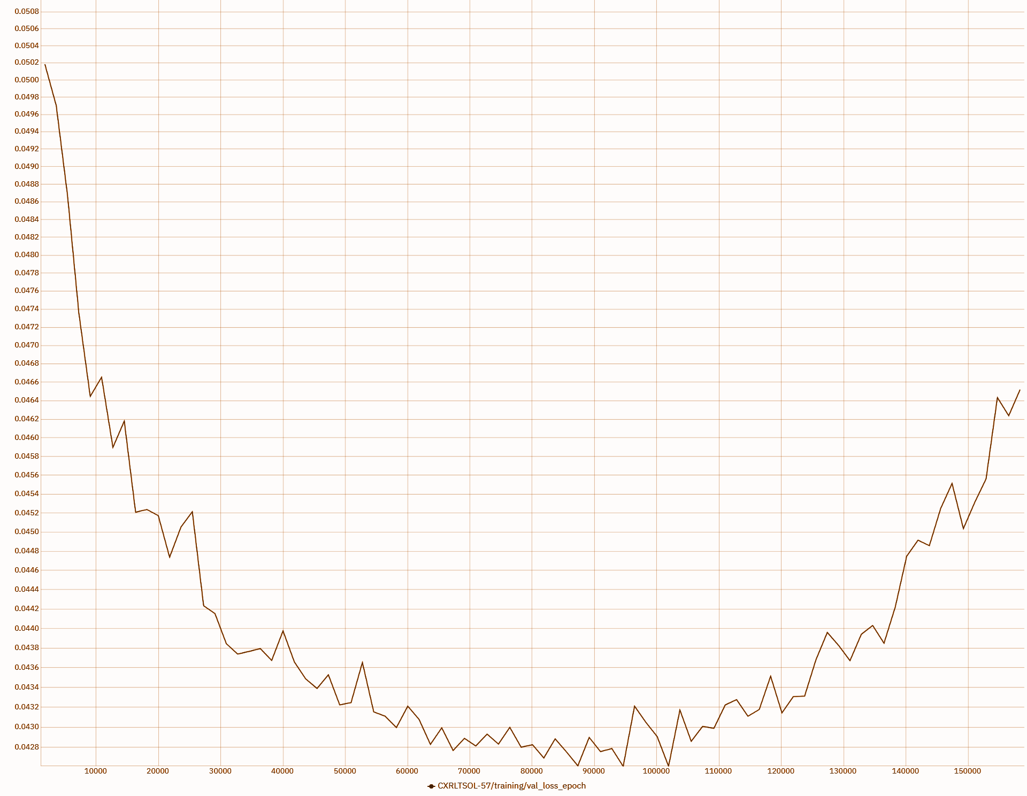
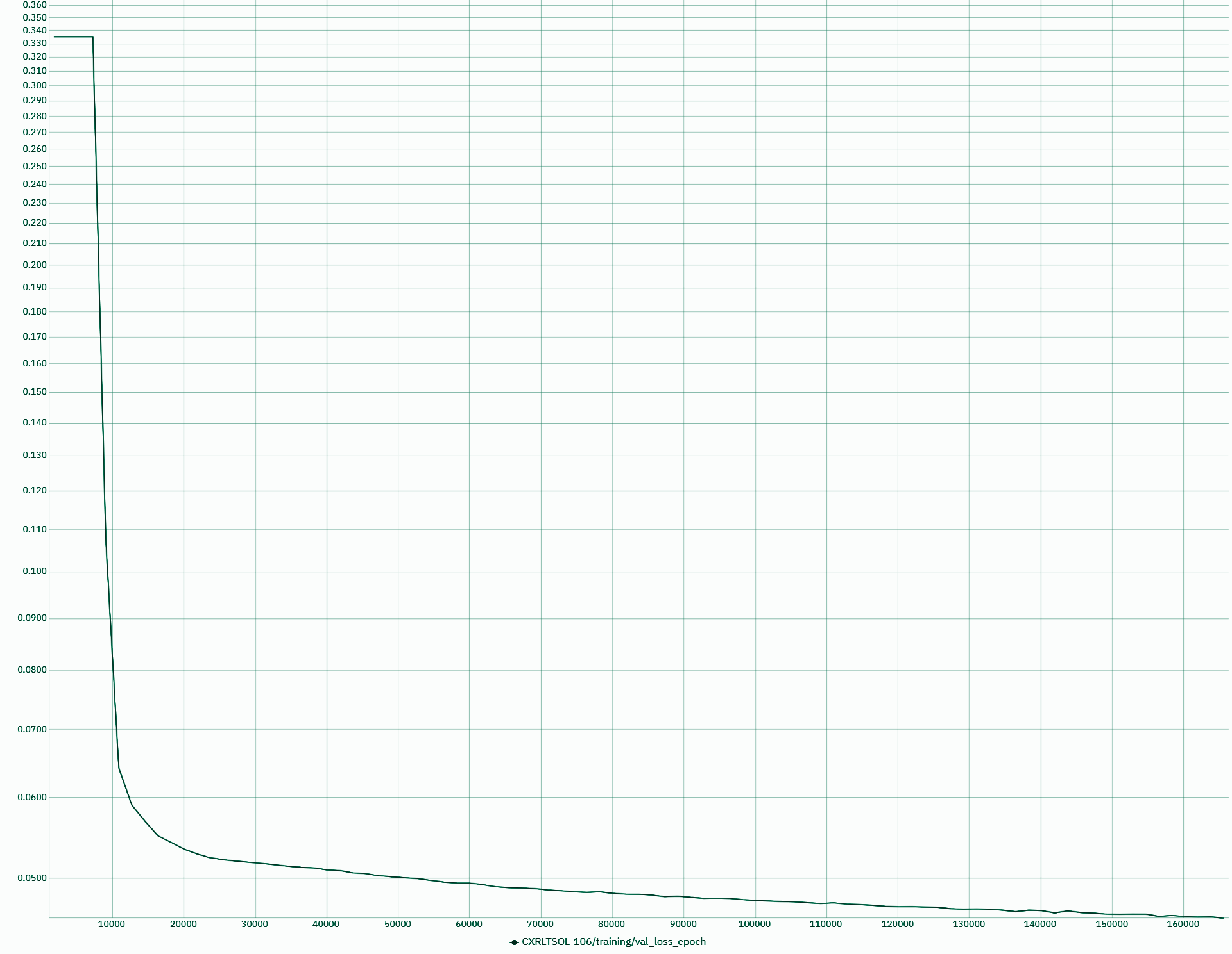
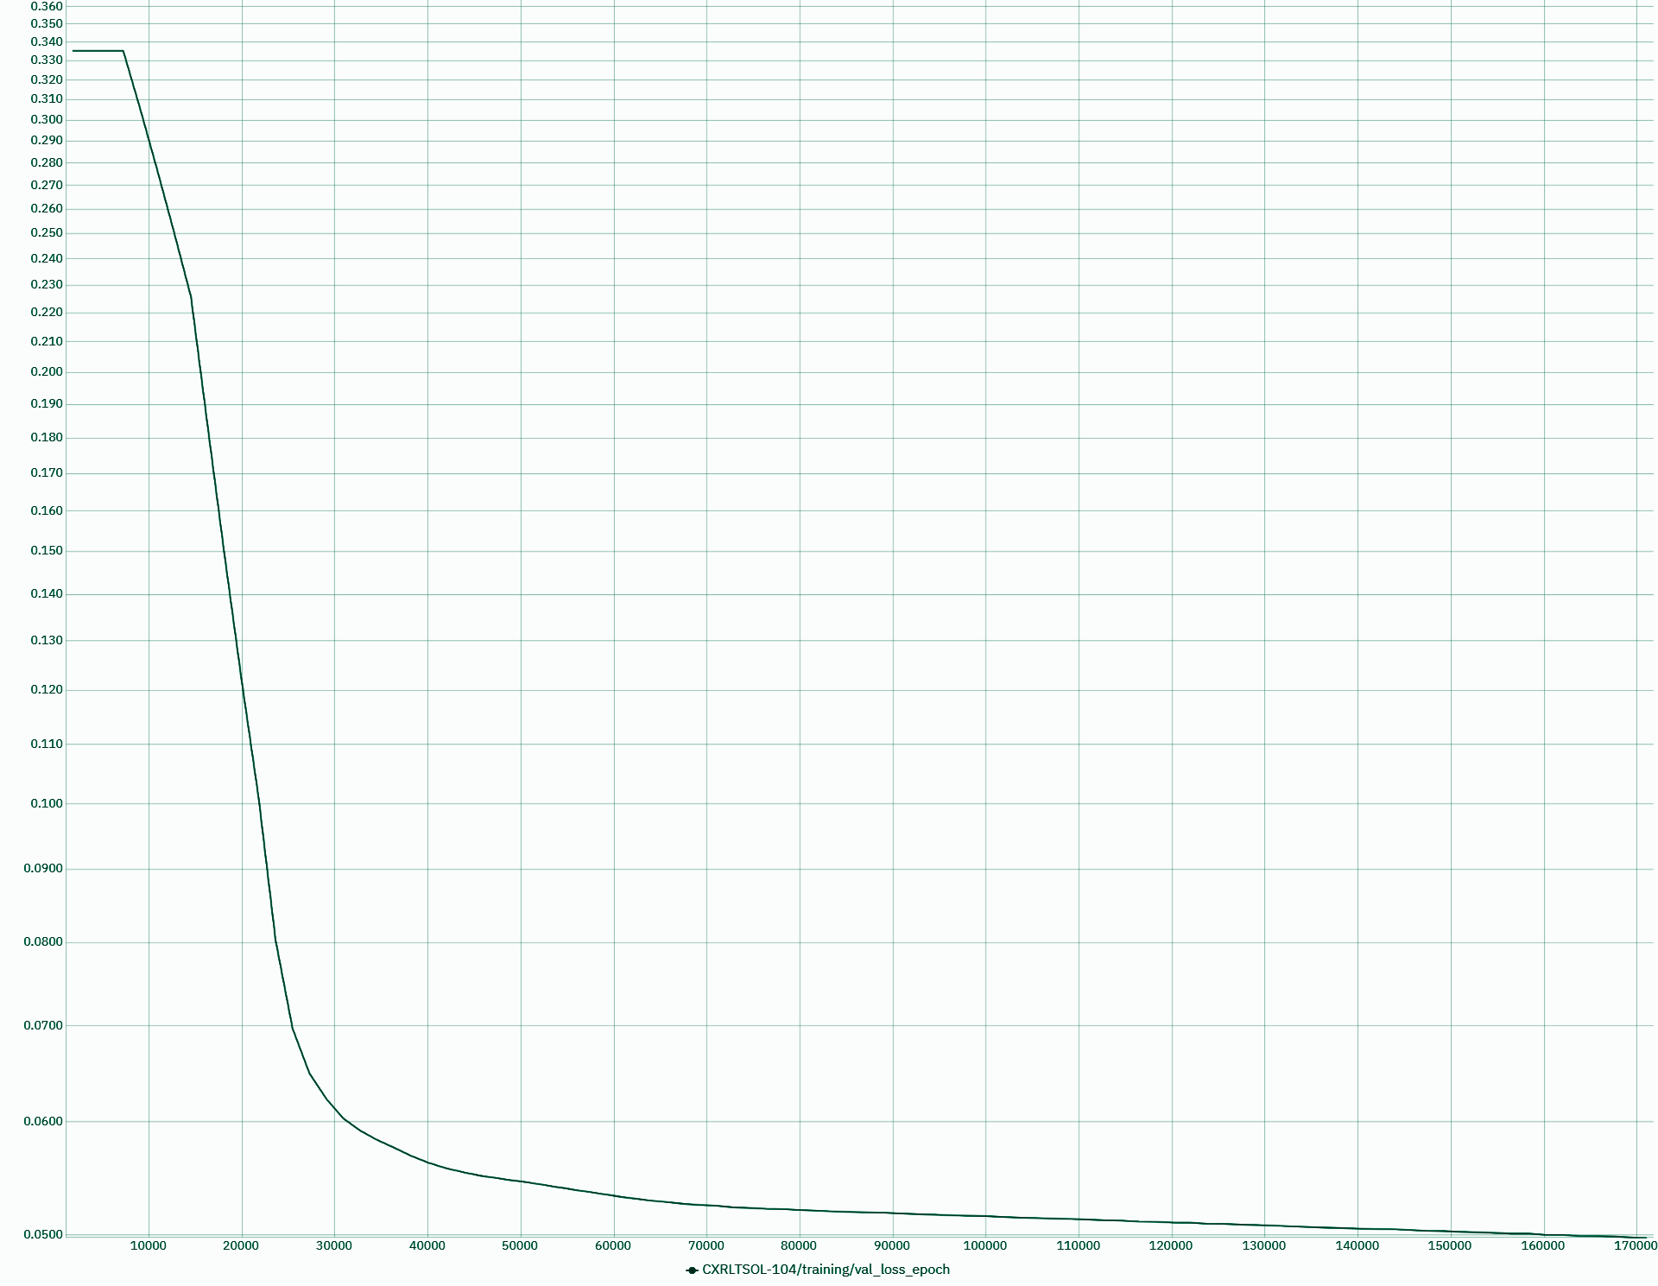
Stabilize the training
Adding warm up stage
ConvNeXt-B-224, no warm up
ConvNeXt-B-384, no warm up
ConvNeXt-B-Clip, no warm up
ConvNeXt-B-224, warm up 1000
ConvNeXt-B-384, warm up 10

Slide 21
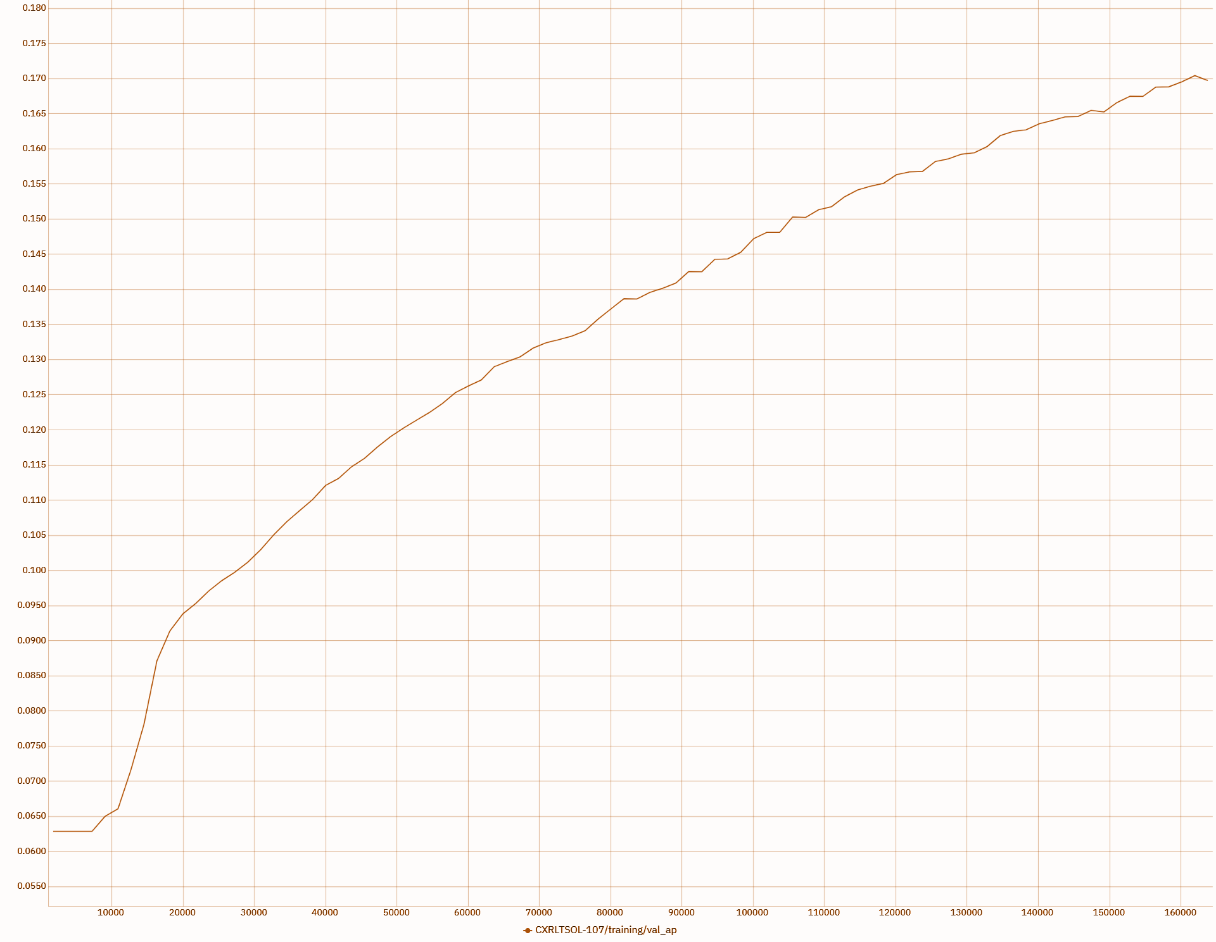
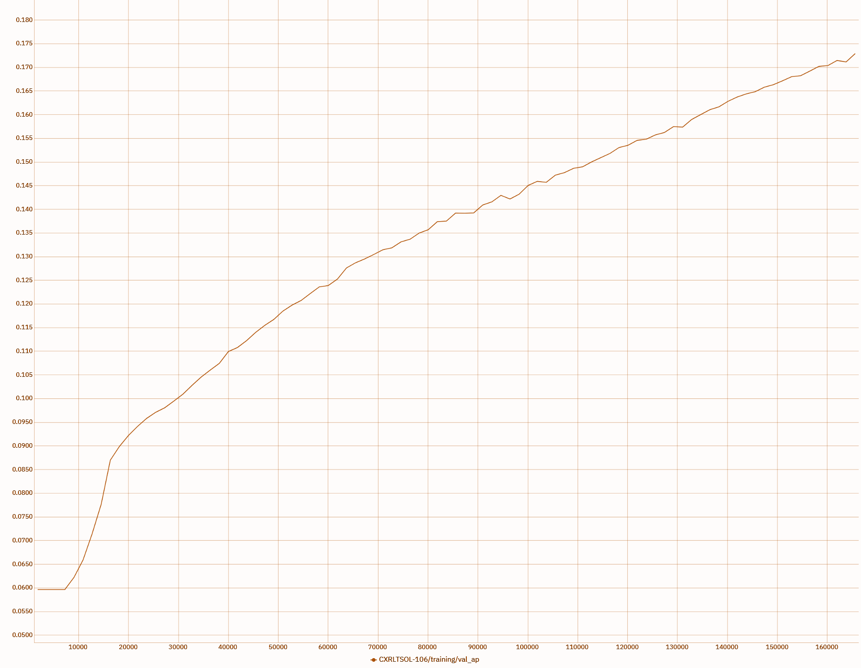
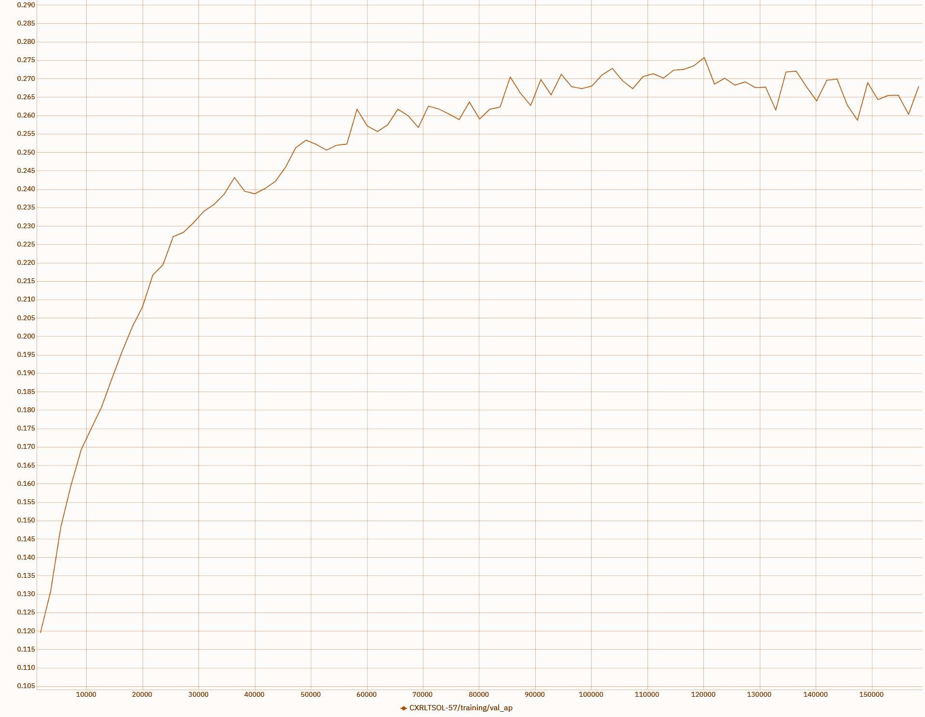
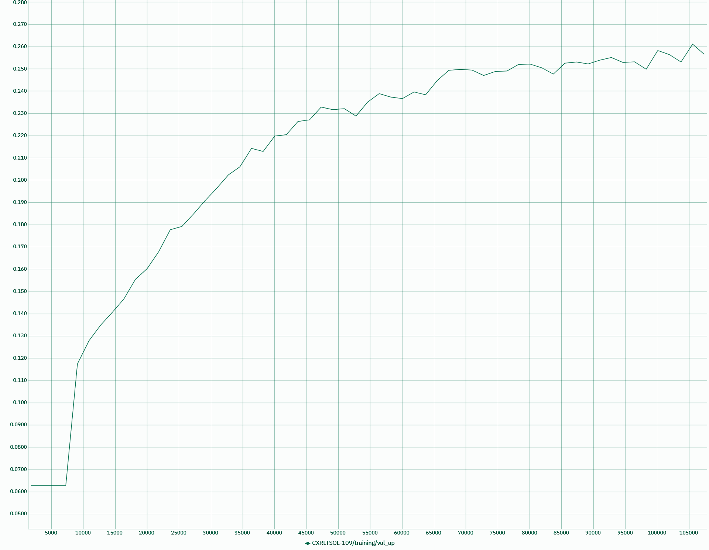
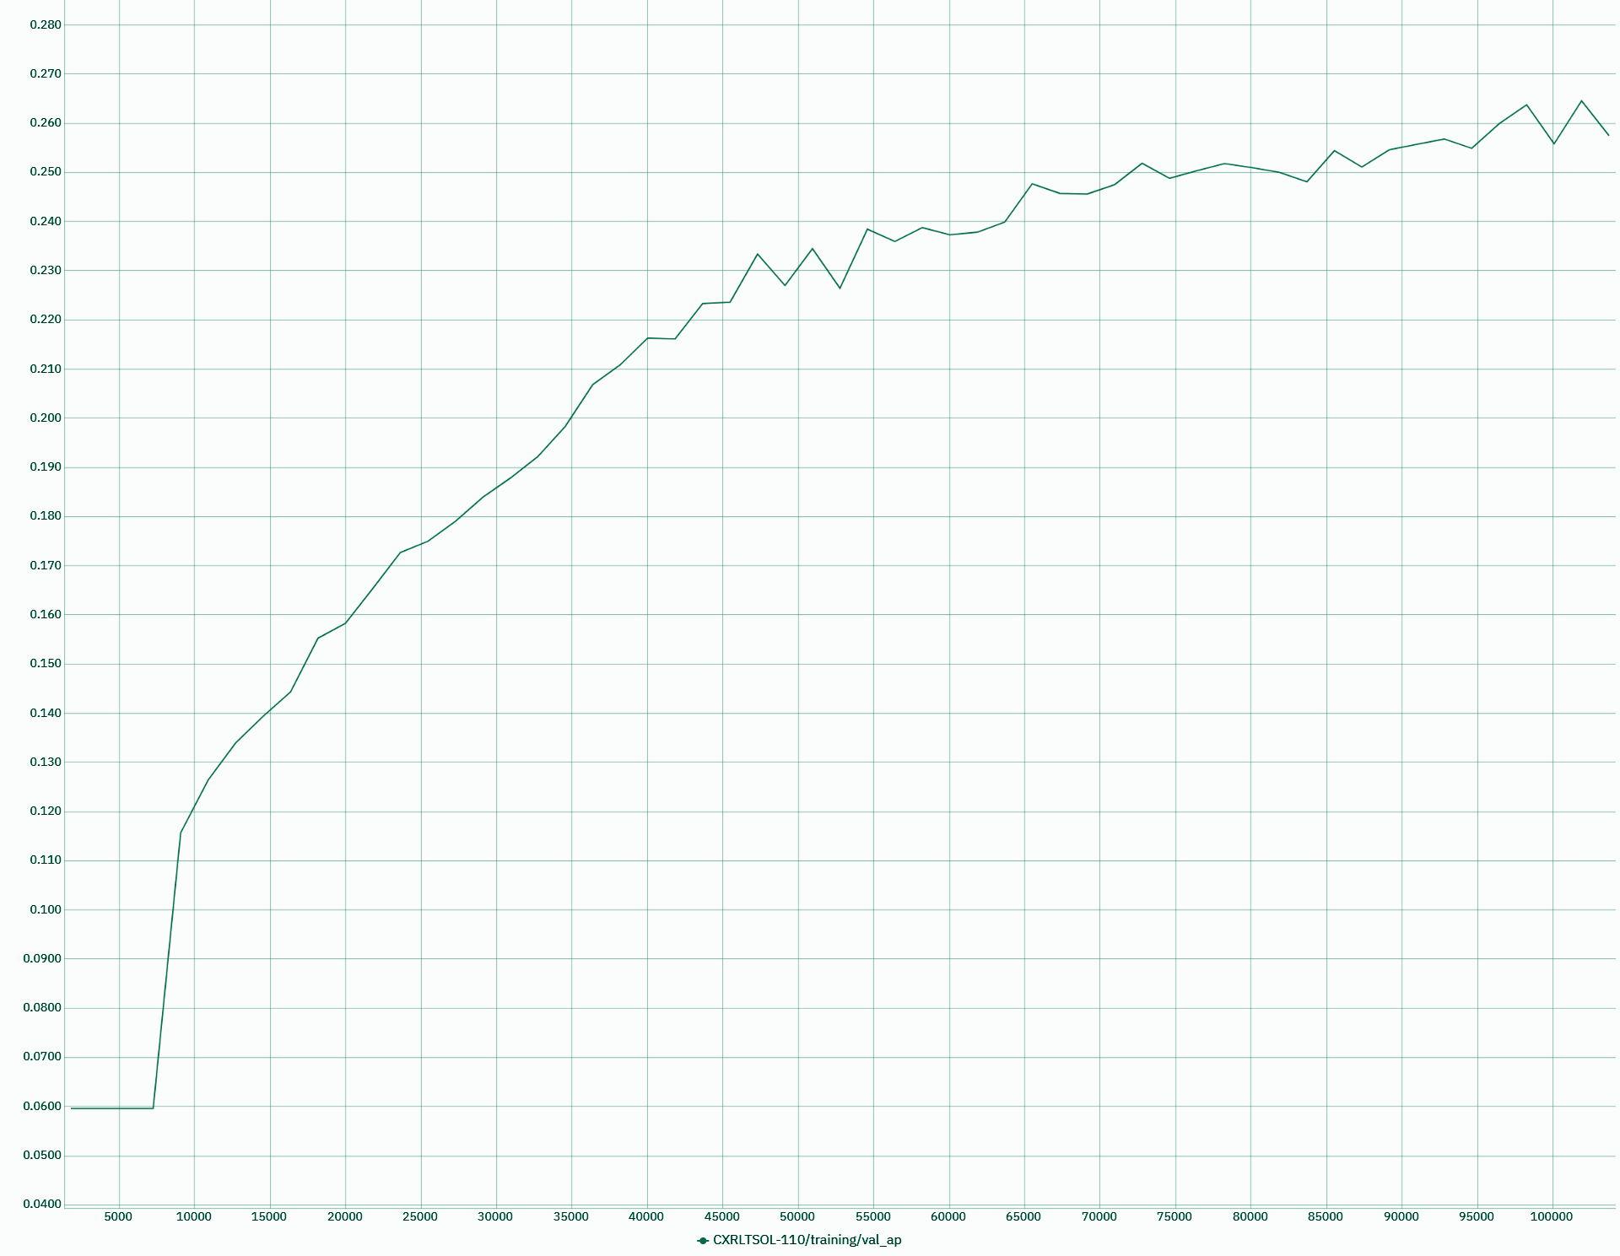
Stabilize the training
Adjust learning rate
ConvNeXt-B-224, warm up 10, lr 6e-5
ConvNeXt-B-384, warm up 10, lr 6e-5
ConvNeXt-B-Clip, no warm up, lr 5e-6
ConvNeXt-B-224, warm up 10, lr 6e-3
ConvNeXt-B-384, warm up 10, lr 6e-3

